Slide 1
Real time physics applied to shrapnel on a destructible terrain
Guillaume NOISETTE
Fabien SACRISTE

Slide 2
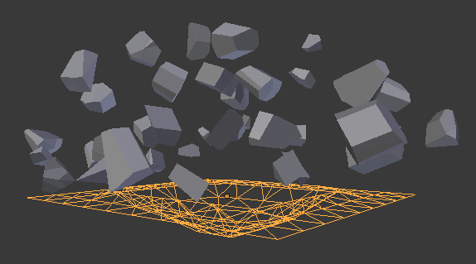
Summary
Create an environment where the terrain is destructible, aiming to generate a cratere due to an explosion.

Slide 3
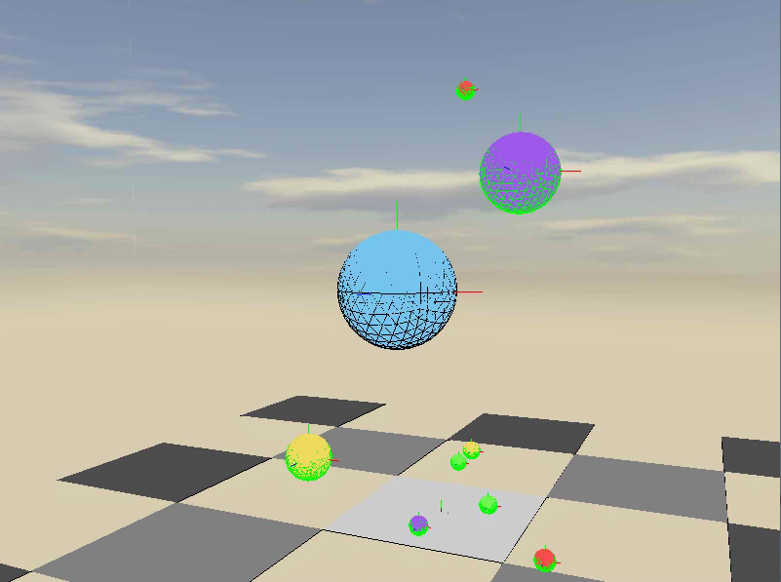
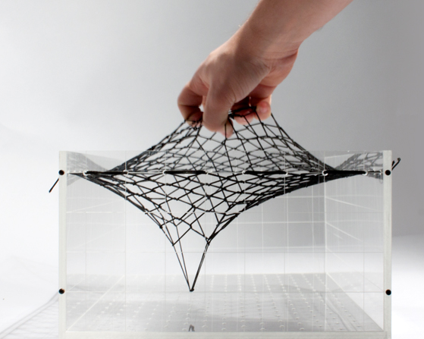
Main features
Basic physic engine
Mesh deformation

Slide 4
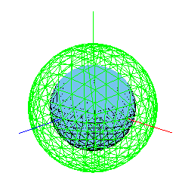


The physic engine
GameObjects
RigidBodies
Gravity
Collision system
Forces applied system (impact force, quaternion)

Slide 5
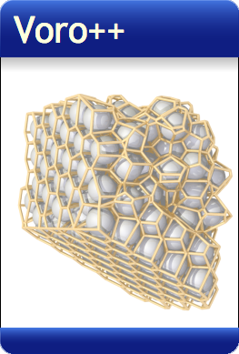
Mesh deformation
Delaunay triangulation
Paraboloid deformation
3D Voronoï (lib. voro++)
Voro++ : http://math.lbl.gov/voro++/

Slide 6
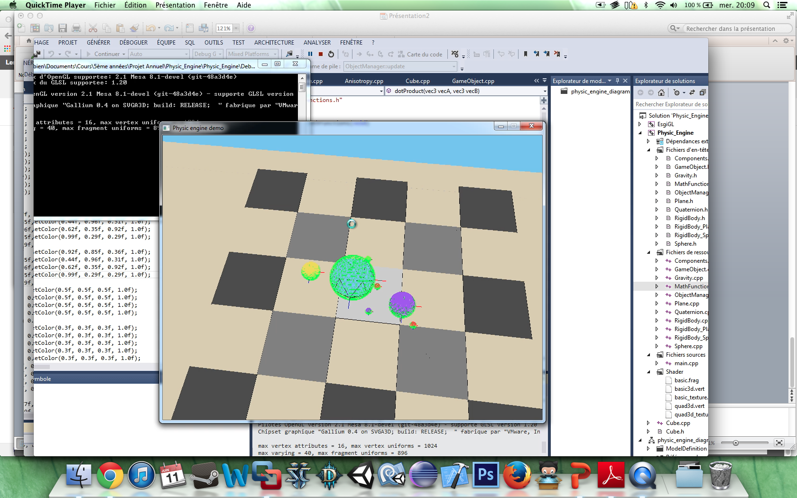
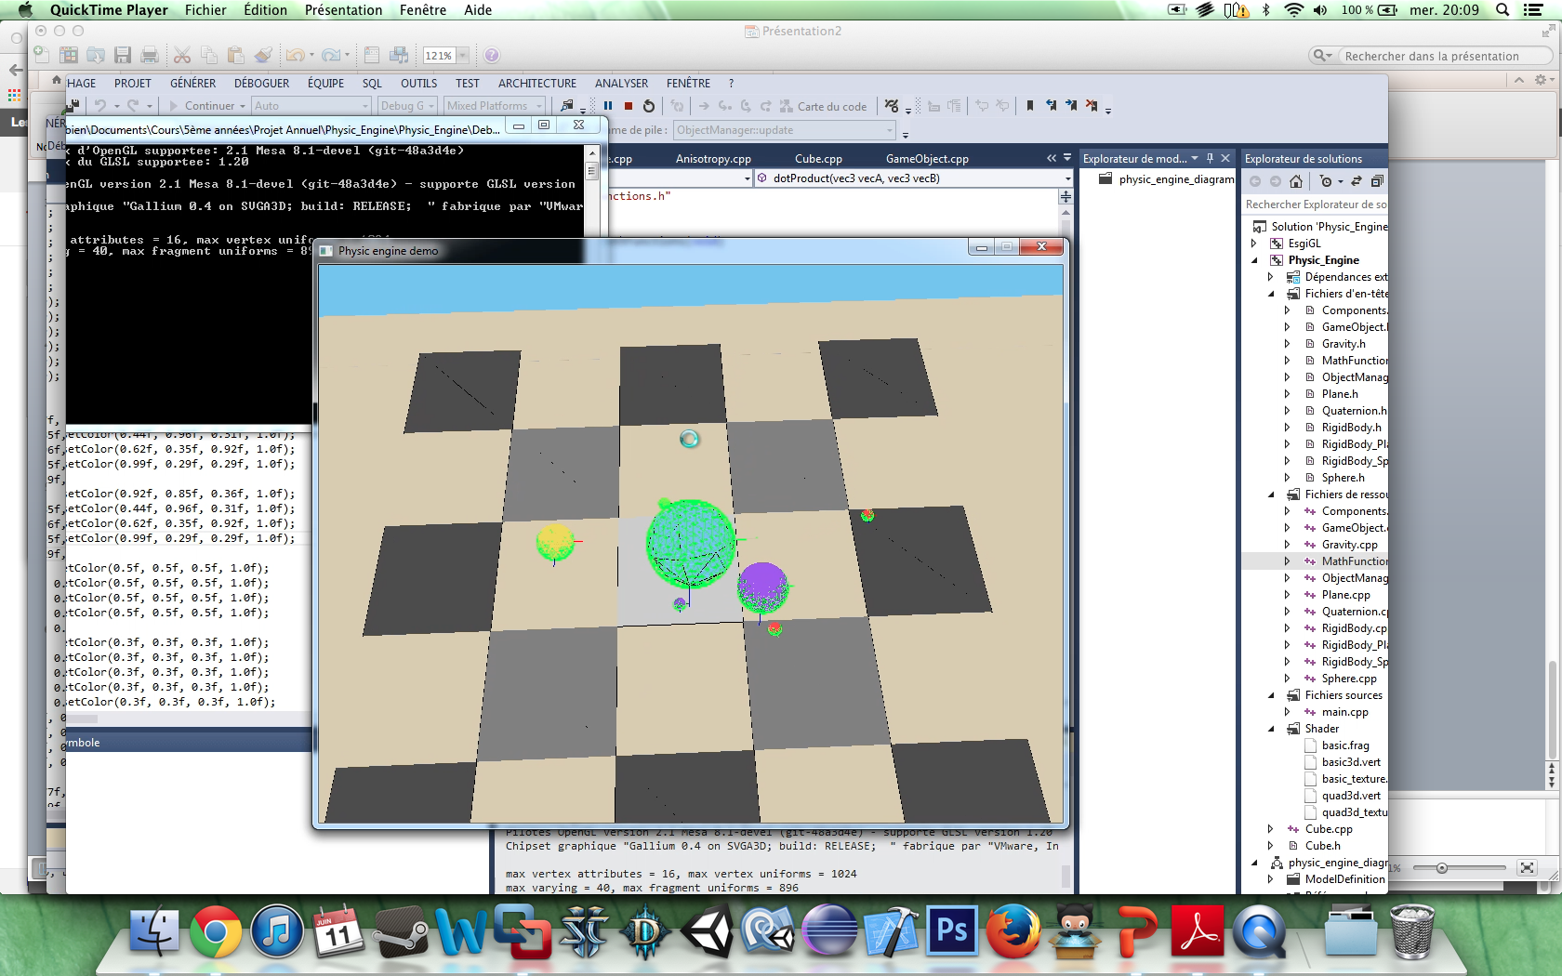
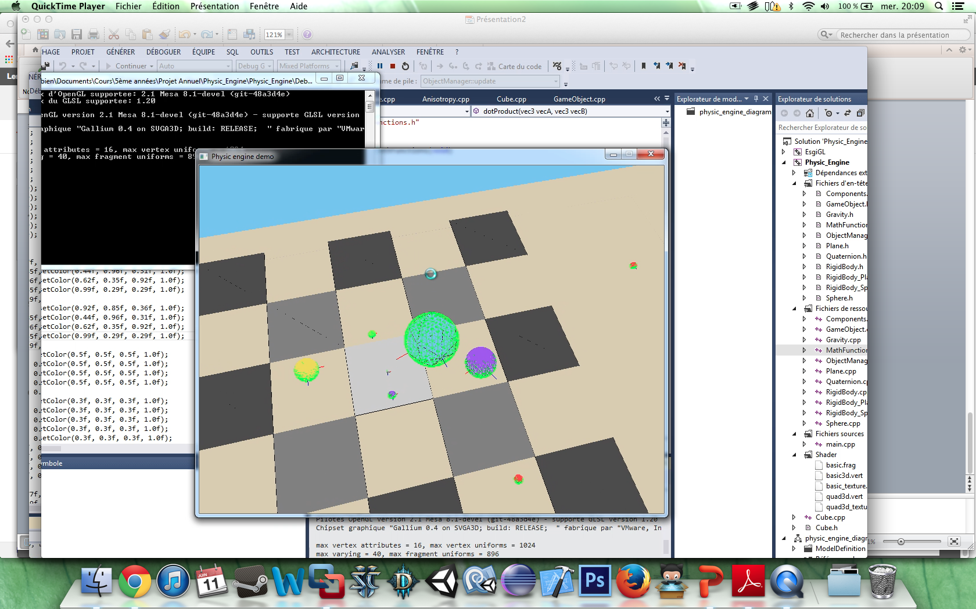
Physic engine objects’ interaction

Slide 7
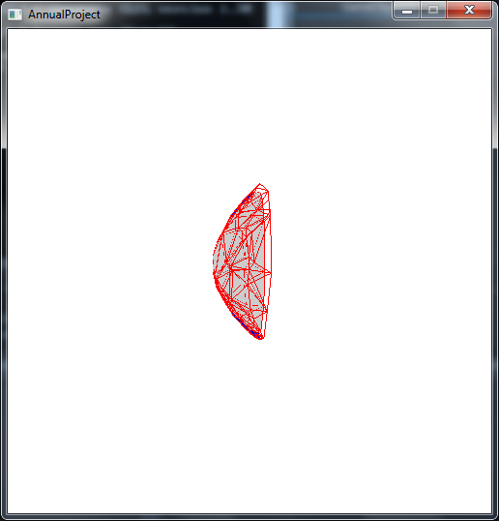
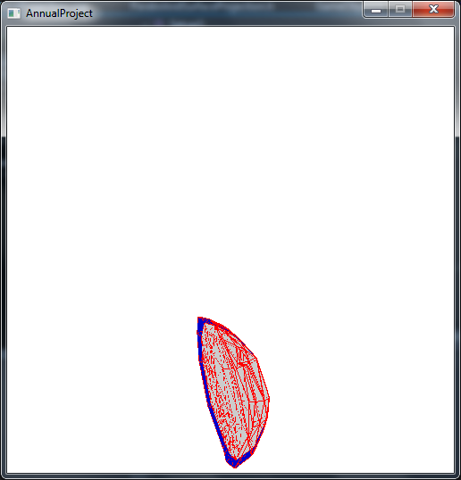
Mesh deformation

Slide 8
Future
Keeping improving the physic engine (optimization, manage more complicated objects, multithread…)
Improve render
Import/Export external 3D mesh
Pit intersection

Slide 9
Problems
Facing the main and common problems of the physic and all the rules applied to the world and its environment.
Collision system in between different game objects.
Use of the external library : voro++

Slide 10
Thank you for your attention

